Slide 1
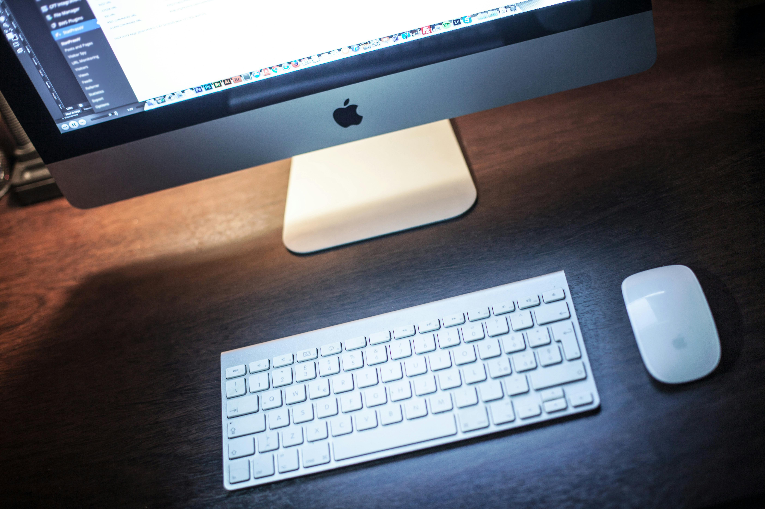
What is computer ?
A computer is a programmable device that stores, retrieves, and processes data. The term "computer" was originally given to humans (human computers) who performed numerical calculations using mechanical calculators, such as the abacus and slide rule. The term was later given to mechanical devices as they began replacing human computers. Today's computers are electronic devices that accept data (input), process that data, produce output, and store (storage) the results (IPOS).

Slide 2
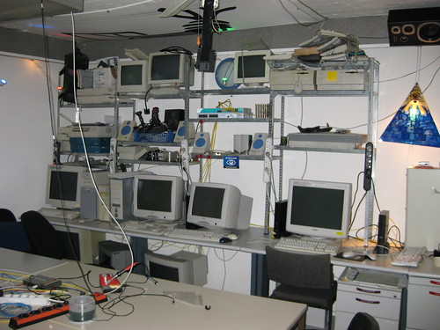
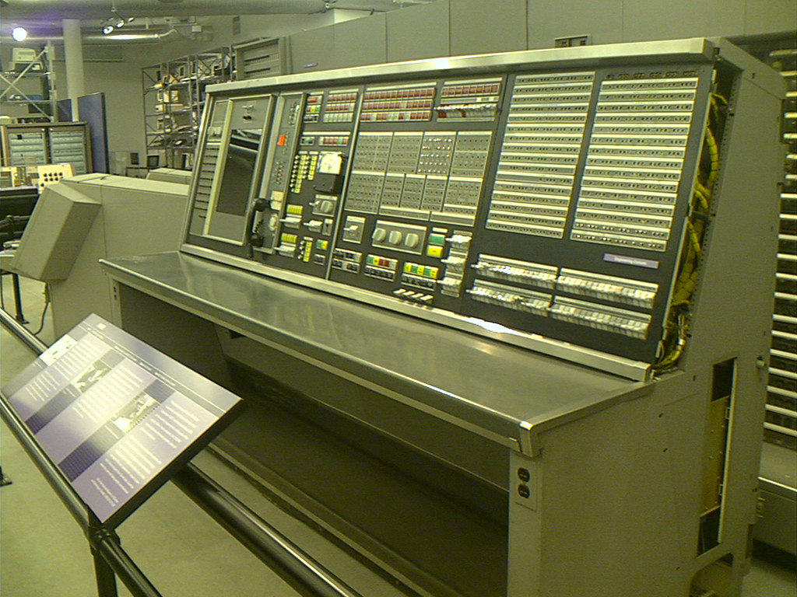
The first digital computer was called the ENIAC (Electronic Numerical Integrator and Computer), built during World War II (1943-1946) to help automate calculations done by human computers¹. Early computers used vacuum tubes and were large, sometimes room-sized, and found in businesses, universities, or governments. Later, computers began utilizing transistors and smaller, cheaper parts that allowed the ordinary person to own a computer¹.
Modern computers perform a wide range of tasks through programs, which are sets of operations that the computer can perform automatically. A computer system may refer to a complete computer that includes the hardware, operating system, software, and peripheral equipment needed for full operation, or to a group of computers that are linked and function together, such as a computer network or cluster

Slide 3
Computers have the ability to:
Store information.
Retrieve data.
Process data using algorithms and logical operations.
Display results or output.
They are essential tools in today’s digital age, impacting various aspects of our lives.
Computing Basics:
Computers can be used for:
Typing documents.
Computers are used in a variety of ways today, from writing letters in word processors to complex calculations and data analysis. They are also at the core of many industrial and consumer products, controlling systems like microwave ovens, remote controls, industrial robots, personal computers, and mobile devices². Computers power the Internet, which links billions of computers and users worldwide²
Computing Basics:
1. computers can be used for :
2.Sending emails
3.Playing games.
4.Browsing the web.
Editing or creating spreadsheets, presentations, and videos .
Their capacity to handle large amounts of data has revolutionized fields like weather forecasting, telecommunications, and scientific research.
Computers are also embedded in everyday appliances, making them “smart.”

Slide 4
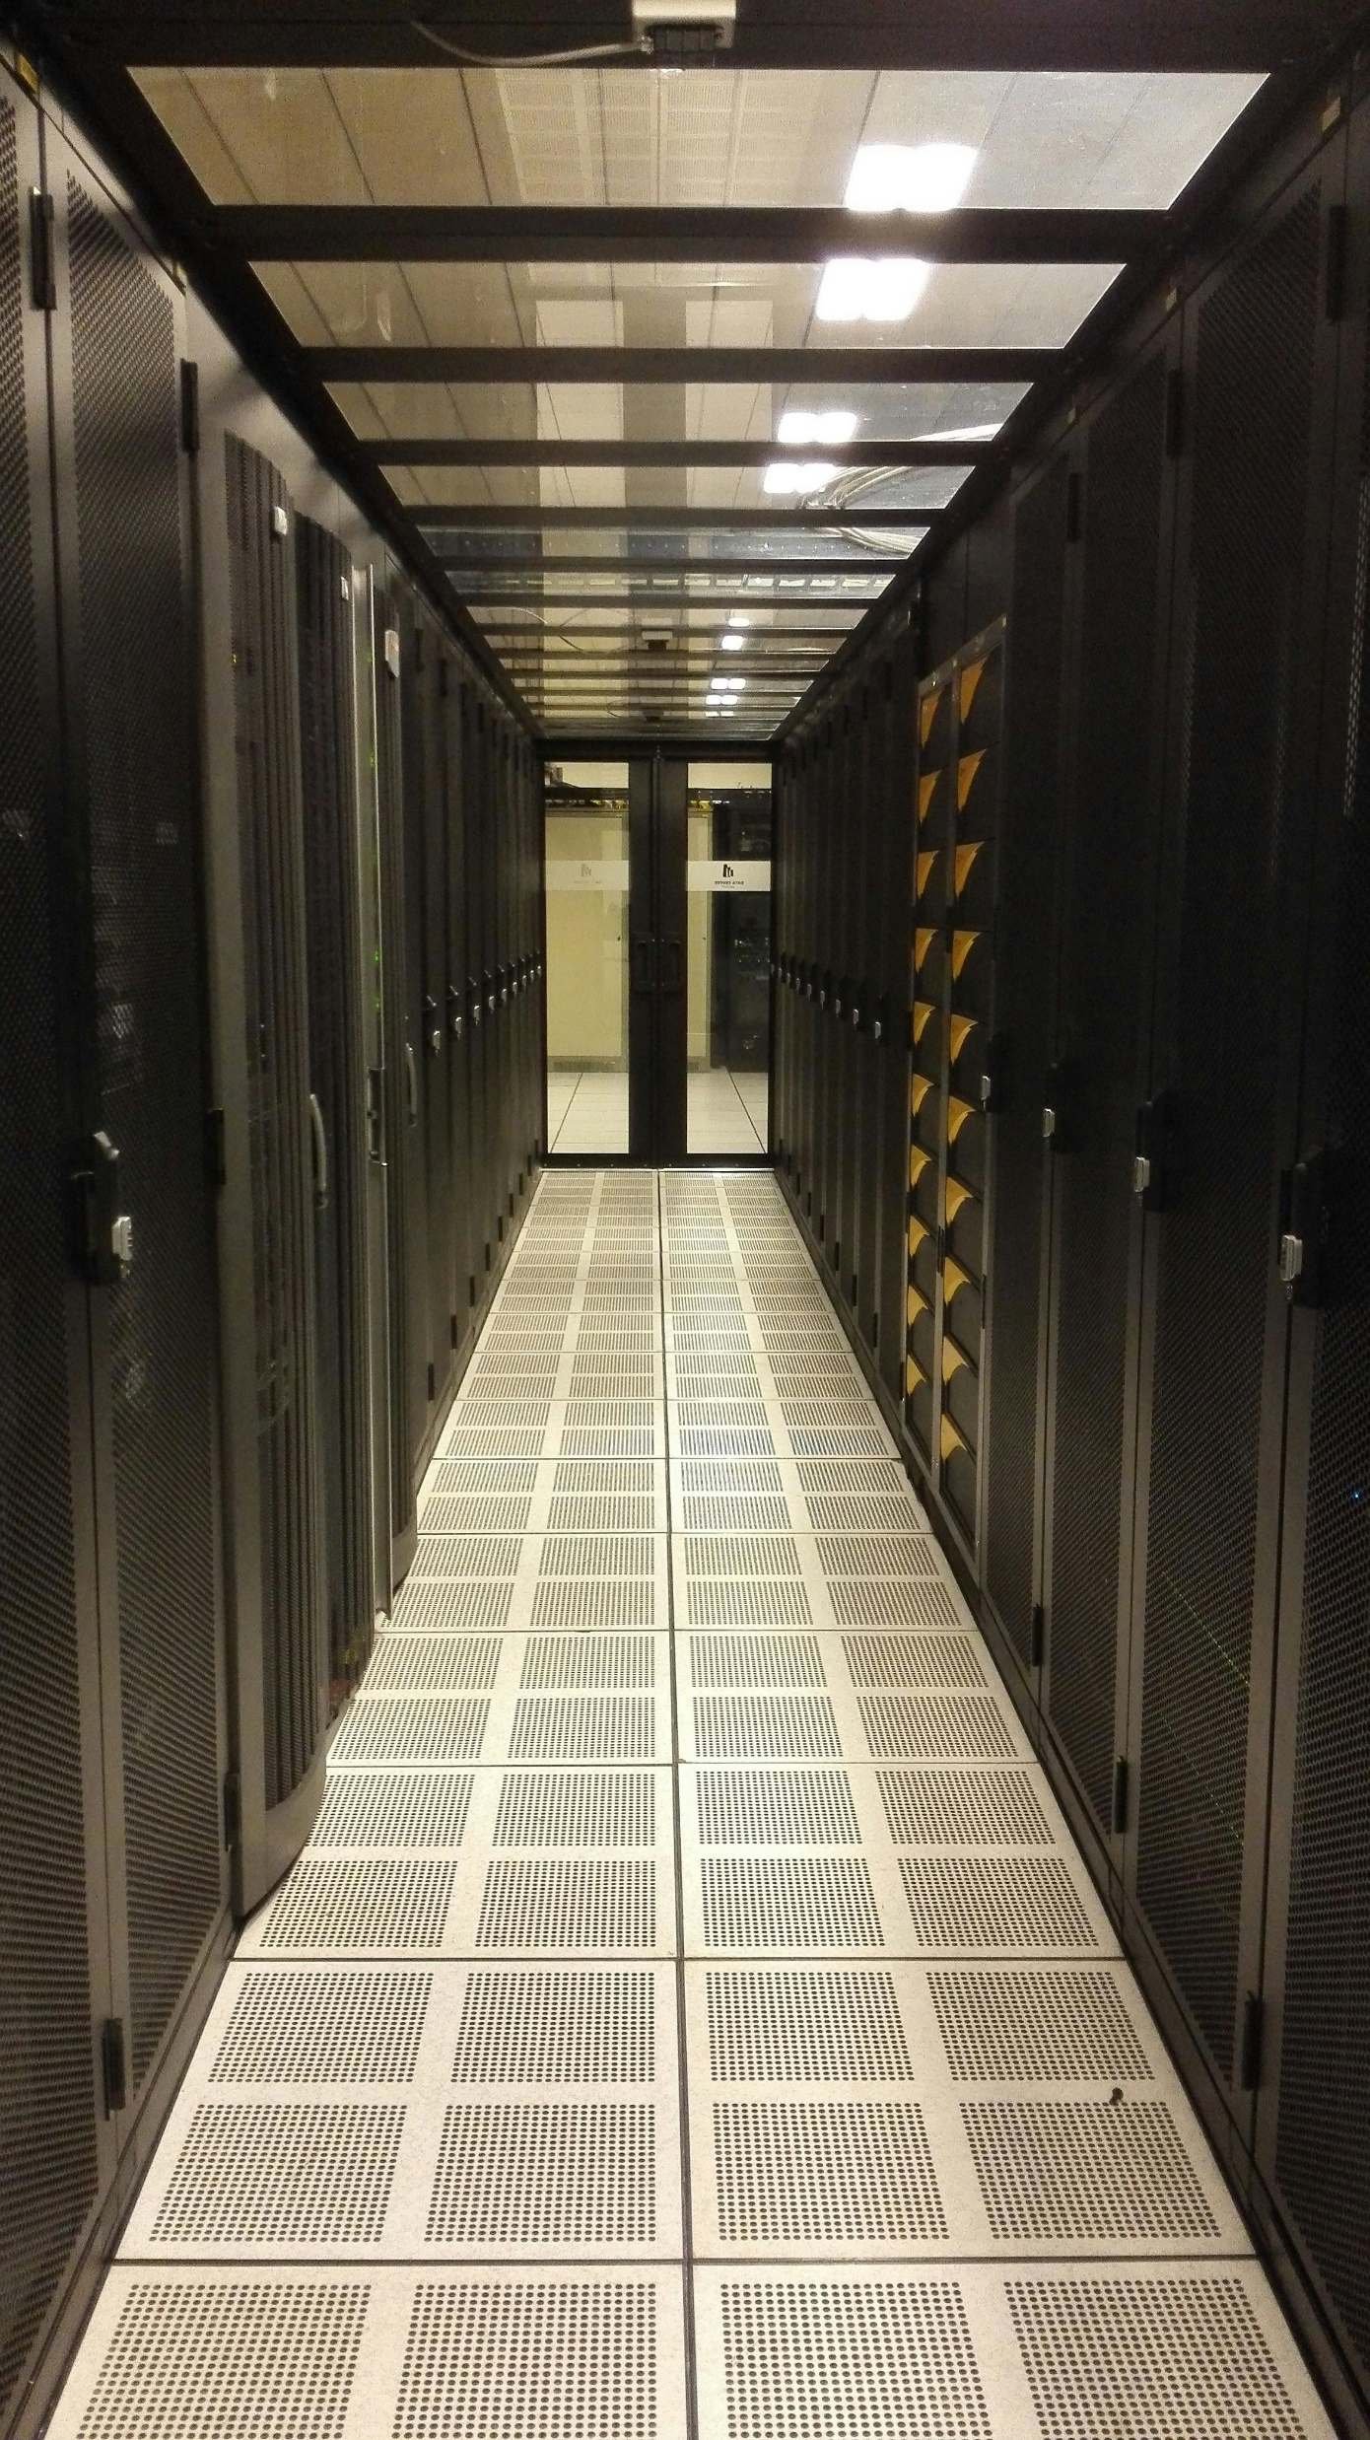
Certainly! Computers come in various types, each serving different purposes. Let’s explore them based on size and data handling capabilities:
Supercomputer:
These are the fastest computers, capable of processing trillions of instructions or data per second.
Used for scientific simulations, weather forecasting, and nuclear energy research.
First developed by Roger Cray in 1976 .
2.Mainframe Computer:
Supports hundreds or thousands of users simultaneously.
Ideal for large organizations (e.g., banking, telecom) that process high volumes of data.
High storage capacity and long lifespan.
3.Minicomputer:
Medium-sized multiprocessing computers.
Support 4 to 200 users at once.
Used in institutes, departments, and for tasks like billing, accounting, and inventory management.

Slide 5
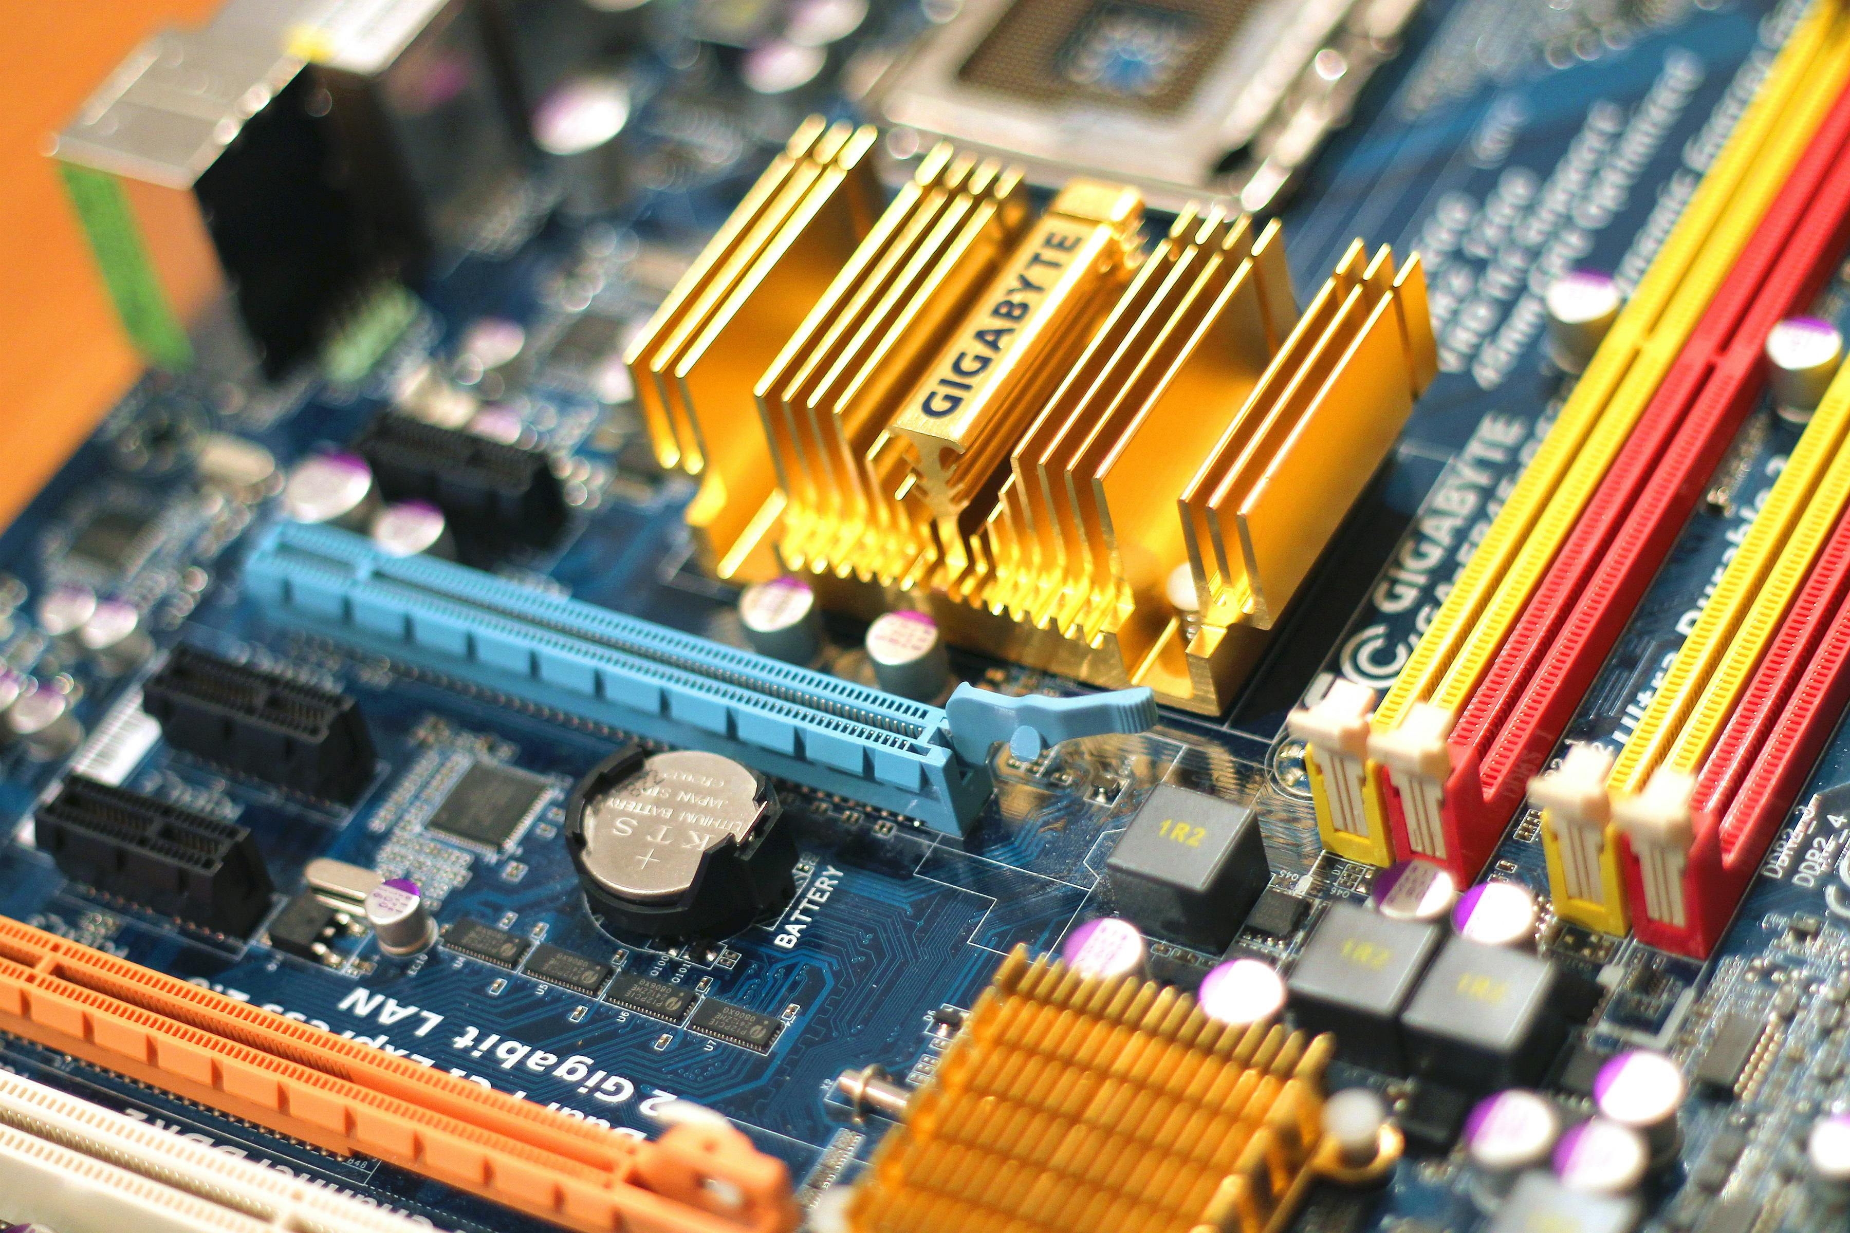
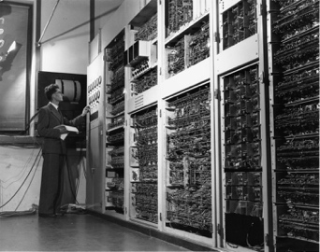
4.Workstation Computer:
High-performance computers used for specialized tasks (e.g., graphic design, engineering).
Often used by professionals in specific fields.
5.Personal Computer (PC):
Intended for personal use.
Includes desktop computers and laptops.
Used for general computing tasks, entertainment, and productivity.
6.Server Computer:
Provides functionality for clients (other computers or devices).
Used in networks to manage resources, host websites, and handle data requests.
7.Analog Computer:
Processes continuous data using physical quantities (e.g., voltage, current).
Rarely used today but historically important.
8.Digital Computer:
Processes discrete data using binary digits (0s and 1s).
Most common type of computer today.
9.Hybrid Computer:
Combines analog and digital components.
Used in specialized applications (e.g., control systems, simulations).
10.Tablets and Smartphones:
Portable devices with computing capabilities.
Tablets are flat, mobile computers.

